Slide 1

Oracle Siebel vs. Custom MS Implementation
Overview

Slide 2
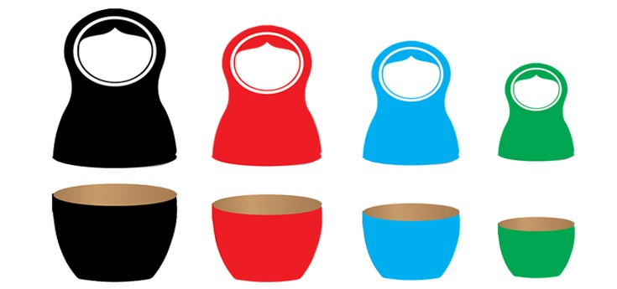
Bespoke(Verbat) vs. COTS (SIEBEL)
Your Exact Needs, No More No Less | Build your application to align with your existing business process instead of changing your process to fit the applications needs
Better Integration with Business | .Net based applications have native integration with office applications (Ex. Outlook and Excel). COTS generally don’t.
Escape Draconian Pricing Models | COTS Pricing models are based on a combination of yearly/user subscriptions rates. This is on top of extra($) for additional features, support and maintenance etc.
Custom Data Models | Bespoke solutions use existing data models or enhanced models; In contrast to migrating existing model to fit COTS
Custom Workflows + Right Level of Automation | Commercial apps can tend to not meet the unique needs of an existing business process . Custom Workflows offer greater flexibility. COTS automation tools are based on industry averages. Often not needed for many Org’s.
Easier to Use | Applications build to meet the requirements of the users tend to be more user friendly. COTS forces employees to learn new methods and processes
Killer Analytics | Analytics that matter to the organization…

Slide 3
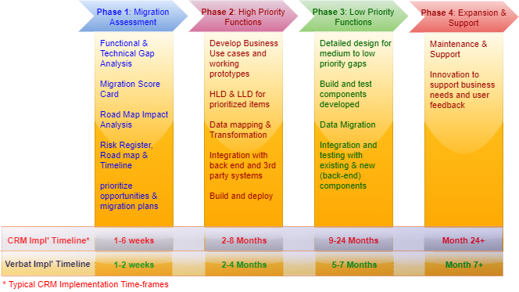
CRM !mplementation: At a Glance

Slide 4
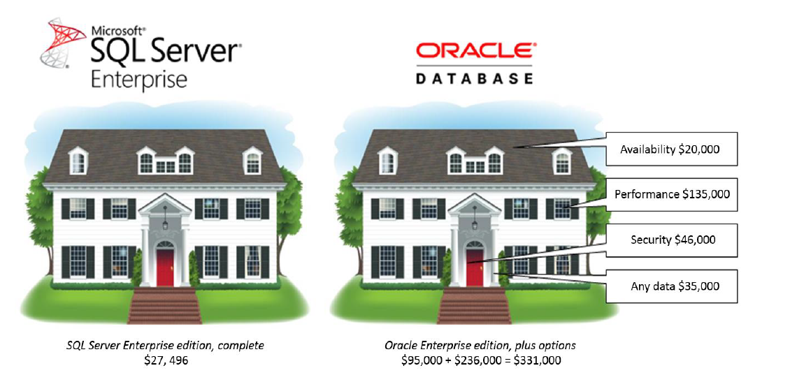
QUICK Comparison

Slide 5
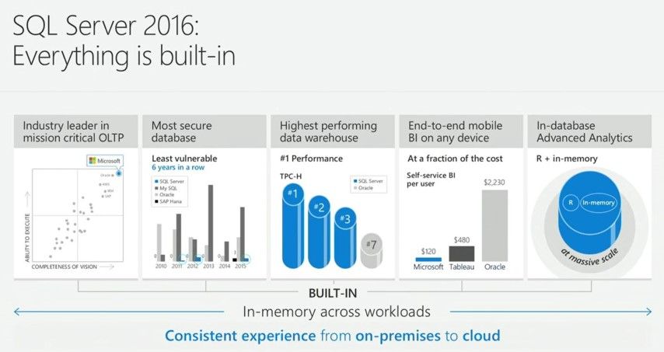
FEATURE Comparison

Slide 6
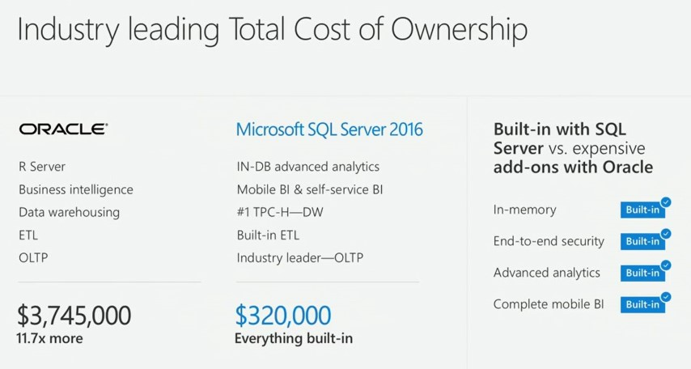
PRICE Comparison

Slide 7
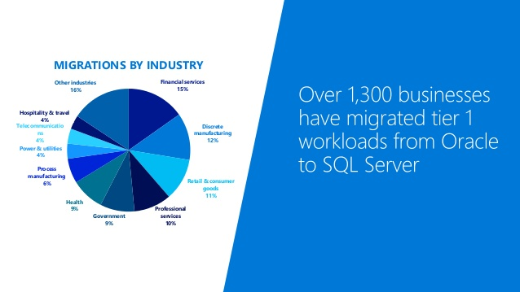
EMERGING Trend

Slide 8
Thank You

